Slide 1
MIT Bag Model leads to magnetic moments and other quantities of hadronic states
Reported by 张文轩

Slide 2
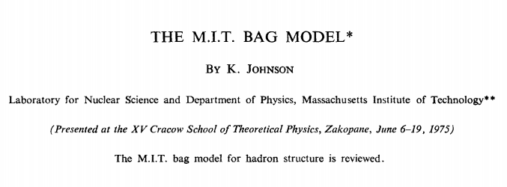
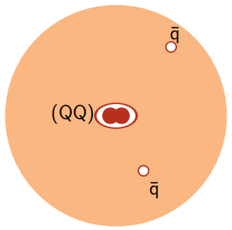
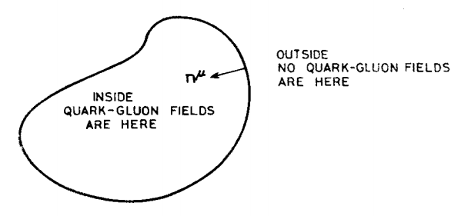
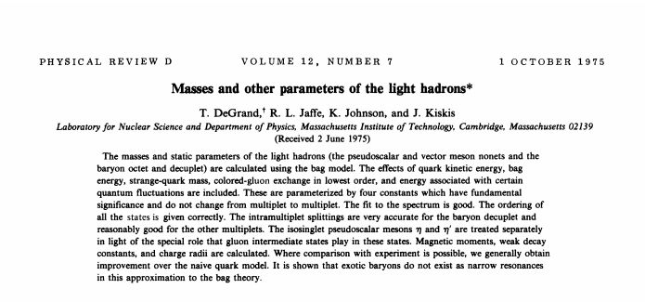
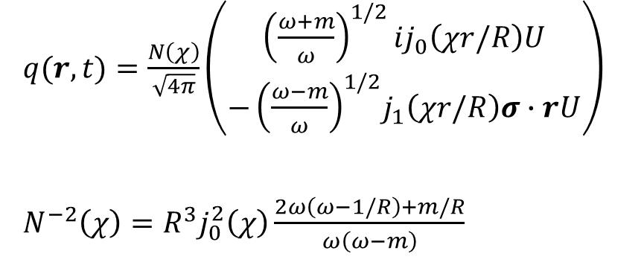
Introduction of MIT Bag Model
K. Johnson, 1975, ACTA Physica Polonica
T. DeGrand, 1975, Physical Review D
$q(r,t)=\frac{N\left(χ\right)}{\sqrt{4π}}\left(\begin{matrix}{\left(\frac{ω+m}{ω}\right)}^{1/2}ij_{0}\left(χr/R\right)U \\ {−\left(\frac{ω−m}{ω}\right)}^{1/2}j_{1}\left(χr/R\right)σ∙rU\end{matrix}\right)$
$N^{−2}\left(χ\right)=R^{3}j_{0}^{2}\left(χ\right)\frac{2ω\left(ω−1/R\right)+m/R}{ω\left(ω−m\right)}$

Slide 3
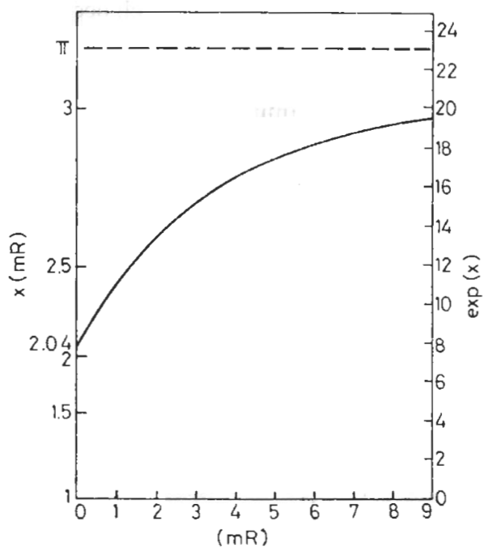
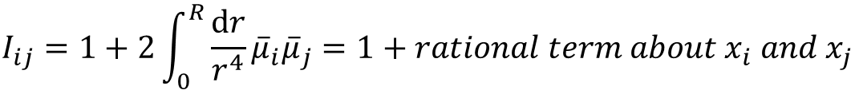
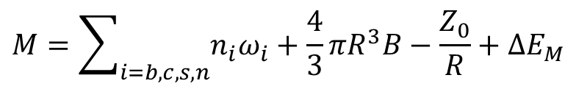

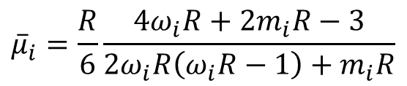

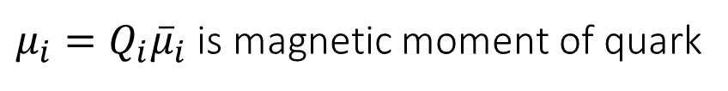
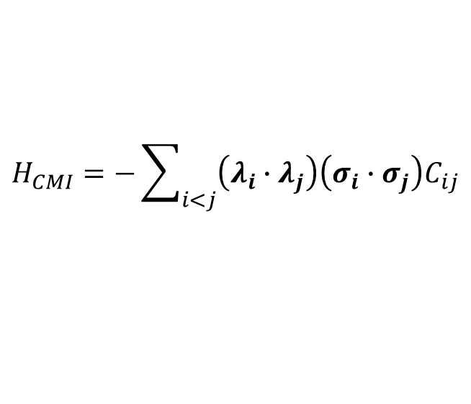
Mass formula of MIT Bag Model
K. Johnson, 1975, ACTA Physica Polonica
T. DeGrand, 1975, Physical Review D
$$M=\sum_{i=b,c,s,n}{n_{i}ω_{i}}+\frac{4}{3}πR^{3}B−\frac{Z_{0}}{R}+ΔE_{M}$$
where $ω_{i}=\begin{aligned}{\left(m_{i}^{2}+x_{i}^{2}/R^{2}\right)}^{1/2}\#\end{aligned}$, and $x_{i}$ satisfies an eigenequation
$$\tan{x_{i}}=x_{i}/\left[1−m_{i}R−{\left(m_{i}^{2}R^{2}+x_{i}^{2}\right)}^{1/2}\right]$$
In the frame of MIT Bag Model, CMI takes the form as
$$H_{CMI}=−\sum_{i<j}{\left(λ_{i}∙λ_{j}\right)\left(σ_{i}∙σ_{j}\right)C_{ij}}$$
$$C_{ij}=3\frac{α_{s}}{R^{3}}{\overline{μ}}_{i}{\overline{μ}}_{j}I_{ij}$$
$${\overline{μ}}_{i}=\frac{R}{6}\frac{4ω_{i}R+2m_{i}R−3}{2ω_{i}R\left(ω_{i}R−1\right)+m_{i}R}$$
$μ_{i}=Q_{i}{\overline{μ}}_{i}$ is magnetic moment of quark
$$I_{ij}=1+2\int_{0}^{R}{\frac{dr}{r^{4}}{\overline{μ}}_{i}{\overline{μ}}_{j}}=1+rational term about x_{i} and x_{j}$$

Slide 4
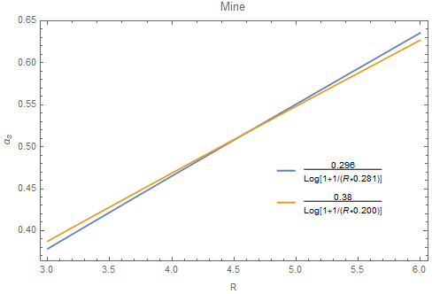
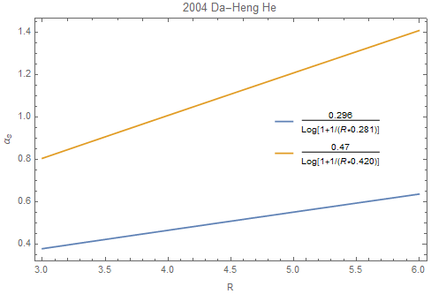
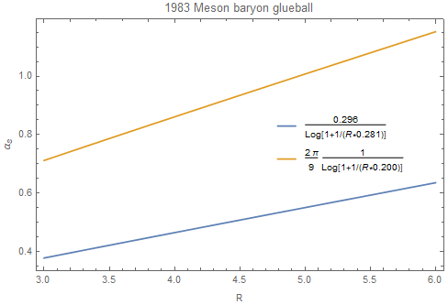
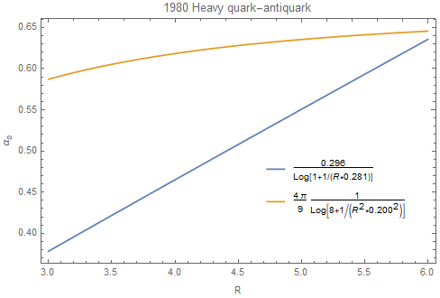
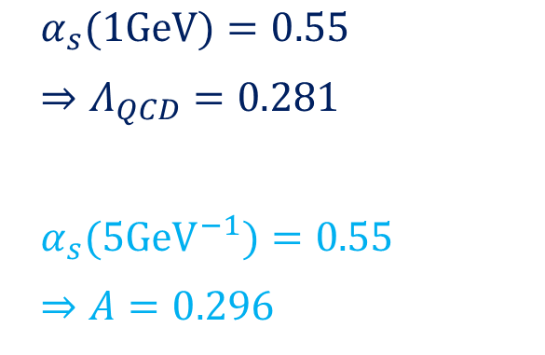
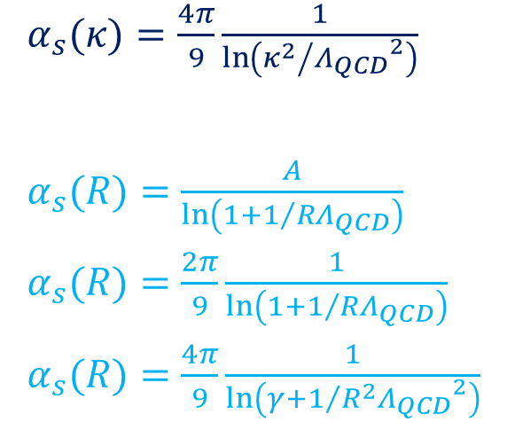
Running Coupling Constant
$α_{s}(κ)=\frac{4π}{9}\frac{1}{\ln\left({κ^{2}}/{{Λ_{QCD}}^{2}}\right)}$
$α_{s}(R)=\frac{A}{\ln\left(1+1/{RΛ_{QCD}}\right)}$
$α_{s}(R)=\frac{2π}{9}\frac{1}{\ln\left(1+1/{RΛ_{QCD}}\right)}$
$α_{s}(R)=\frac{4π}{9}\frac{1}{\ln\left(γ+1/{R^{2}{Λ_{QCD}}^{2}}\right)}$
$α_{s}(1GeV)=0.55$
$⇒Λ_{QCD}=0.281$
$α_{s}(5{GeV}^{−1})=0.55$
$⇒A=0.296$

Slide 5

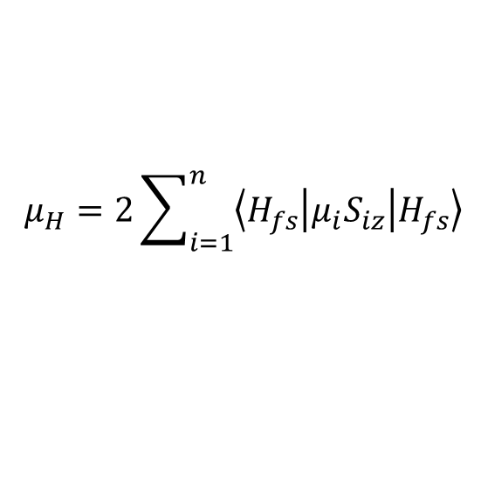
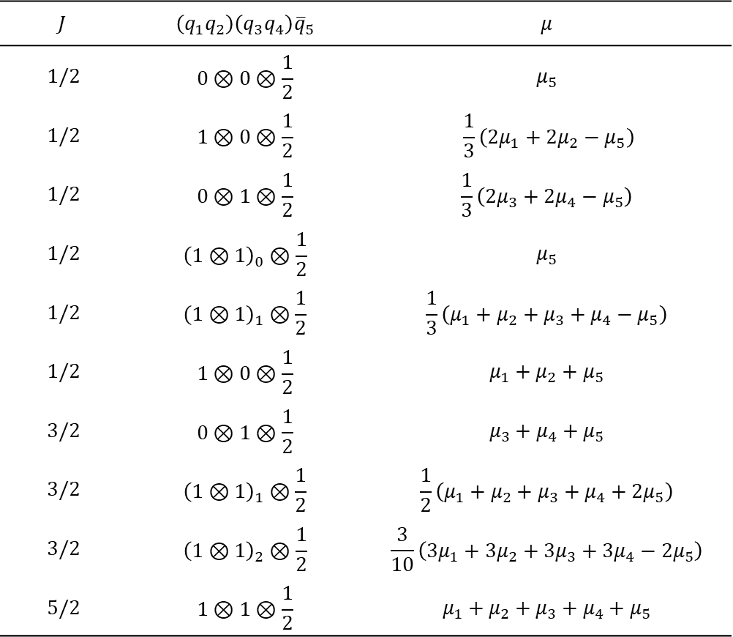
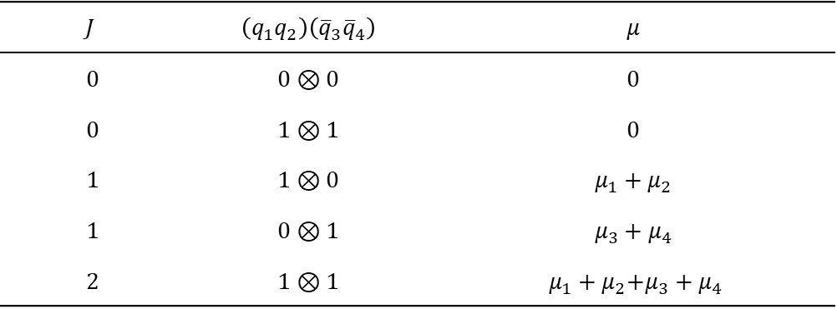
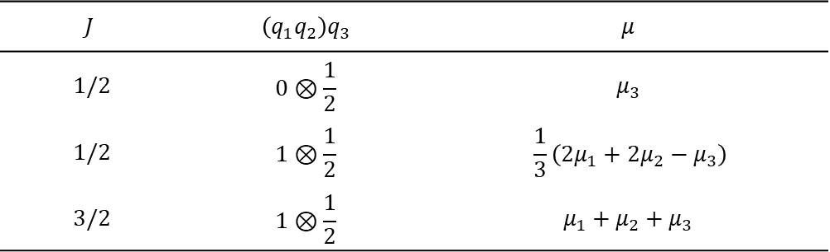
Magnetic Moments
David Griffiths, Introduction to Elementary Particles
A. Bernotas, 2013, Lithuanian Journal of Physics
Guang-Juan Wang, 2016, Physical Review D
$$μ_{H}=2\sum_{i=1}^{n}{\left\langle H_{fs} | μ_{i}S_{iz} | H_{fs}\right\rangle }$$
$$J$$ | $$\left(q_{1}q_{2}\right)\left(q_{3}q_{4}\right){\overline{q}}_{5}$$ | $$μ$$
1/2 | $$0⊗0⊗\frac{1}{2}$$ | $$μ_{5}$$
1/2 | $$1⊗0⊗\frac{1}{2}$$ | $$\frac{1}{3}\left(2μ_{1}+2μ_{2}−μ_{5}\right)$$
1/2 | $$0⊗1⊗\frac{1}{2}$$ | $$\frac{1}{3}\left(2μ_{3}+2μ_{4}−μ_{5}\right)$$
1/2 | $${\left(1⊗1\right)}_{0}⊗\frac{1}{2}$$ | $$μ_{5}$$
1/2 | $${\left(1⊗1\right)}_{1}⊗\frac{1}{2}$$ | $$\frac{1}{3}\left(μ_{1}+μ_{2}+μ_{3}+μ_{4}−μ_{5}\right)$$
1/2 | $$1⊗0⊗\frac{1}{2}$$ | $$μ_{1}+μ_{2}+μ_{5}$$
3/2 | $$0⊗1⊗\frac{1}{2}$$ | $$μ_{3}+μ_{4}+μ_{5}$$
3/2 | $${\left(1⊗1\right)}_{1}⊗\frac{1}{2}$$ | $$\frac{1}{2}\left(μ_{1}+μ_{2}+μ_{3}+μ_{4}+2μ_{5}\right)$$
3/2 | $${\left(1⊗1\right)}_{2}⊗\frac{1}{2}$$ | $$\frac{3}{10}\left(3μ_{1}+3μ_{2}+3μ_{3}+3μ_{4}−2μ_{5}\right)$$
5/2 | $$1⊗1⊗\frac{1}{2}$$ | $$μ_{1}+μ_{2}+μ_{3}+μ_{4}+μ_{5}$$
where $μ_{i}=Q_{i}{\overline{μ}}_{i}$
$$J$$ | $$\left(q_{1}q_{2}\right)q_{3}$$ | $$μ$$
1/2 | $$0⊗\frac{1}{2}$$ | $$μ_{3}$$
1/2 | $$1⊗\frac{1}{2}$$ | $$\frac{1}{3}\left(2μ_{1}+2μ_{2}−μ_{3}\right)$$
3/2 | $$1⊗\frac{1}{2}$$ | $$μ_{1}+μ_{2}+μ_{3}$$
$$J$$ | $$\left(q_{1}q_{2}\right)\left({\overline{q}}_{3}{\overline{q}}_{4}\right)$$ | $$μ$$
0 | $$0⊗0$$ | $$0$$
0 | $$1⊗1$$ | $$0$$
1 | $$1⊗0$$ | $$μ_{1}+μ_{2}$$
1 | $$0⊗1$$ | $$μ_{3}+μ_{4}$$
2 | $$1⊗1$$ | $μ_{1}+μ_{2}$+$μ_{3}+μ_{4}$
?

Slide 6
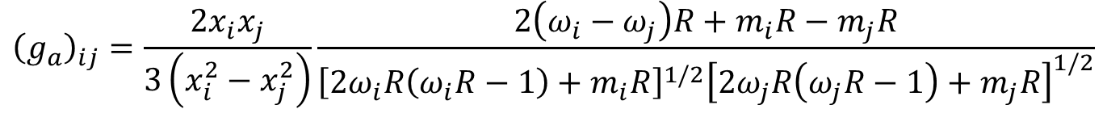
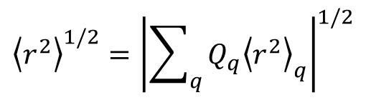
Other quantities
We may calculate mean square charge radius
$${\left\langle r^{2}\right\rangle }_{i}=Q_{i}\frac{ω_{i}R^{3}\left[2x_{i}^{2}\left(ω_{i}R−1\right)+4ω_{i}R+2m_{i}R−3\right]−3m_{i}R^{3}\left[4ω_{i}R+2m_{i}R−2x_{i}^{2}−3\right]/2}{3x_{i}^{2}\left[2ω_{i}R\left(ω_{i}R−1\right)+m_{i}R\right]}$$
$${\left\langle r^{2}\right\rangle }^{1/2}={\left|\sum_{q}{Q_{q}{\left\langle r^{2}\right\rangle }_{q}}\right|}^{1/2}$$
A. Chodos, 1974, Physical Review D
T. DeGrand, 1975, Physical Review D
MIT Bag Model can also be used to study radiative and semi-leptonic decay modes.
$${\left(g_{a}\right)}_{ij}=\frac{2x_{i}x_{j}}{3\left(x_{i}^{2}−x_{j}^{2}\right)}\frac{2\left(ω_{i}−ω_{j}\right)R+m_{i}R−m_{j}R}{{\left[2ω_{i}R\left(ω_{i}R−1\right)+m_{i}R\right]}^{1/2}{\left[2ω_{j}R\left(ω_{j}R−1\right)+m_{j}R\right]}^{1/2}}$$
R. H. Hackman, 1978, Physical Review D
R. Perez-Marcial, 1989, Physical Review D

Slide 7
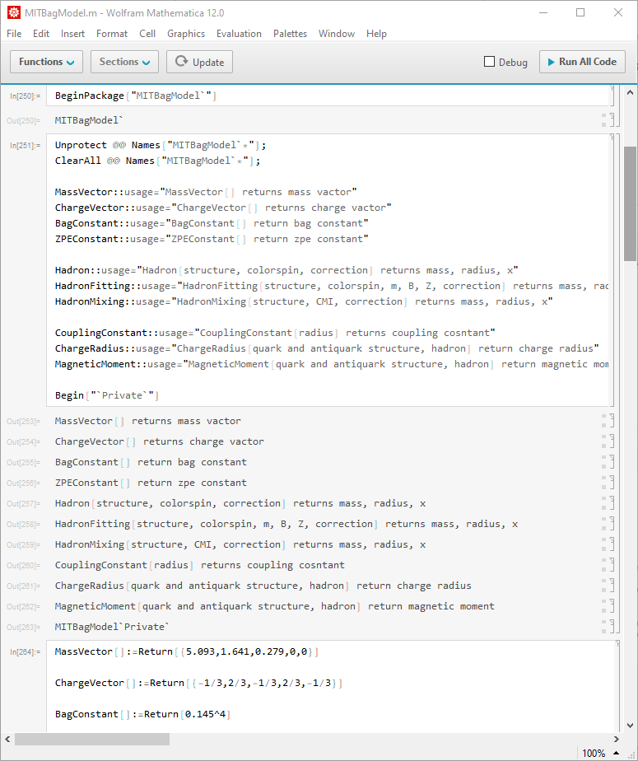
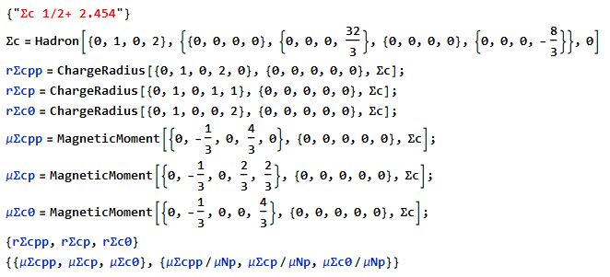
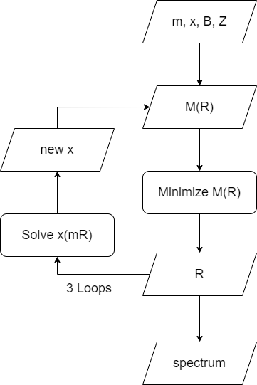
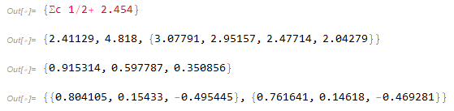
Programing

Slide 8
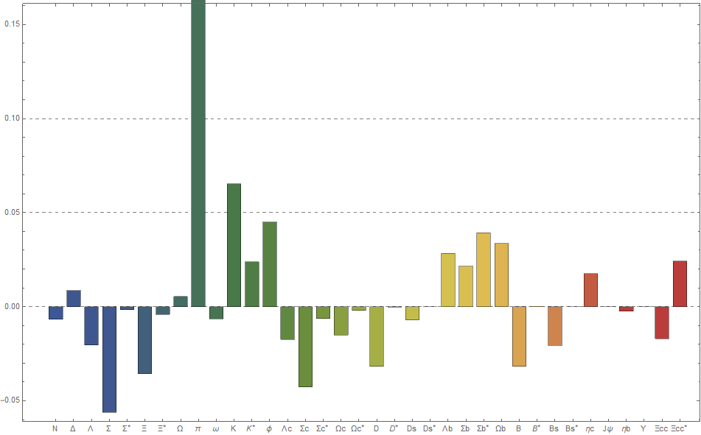
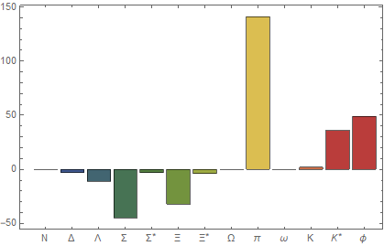
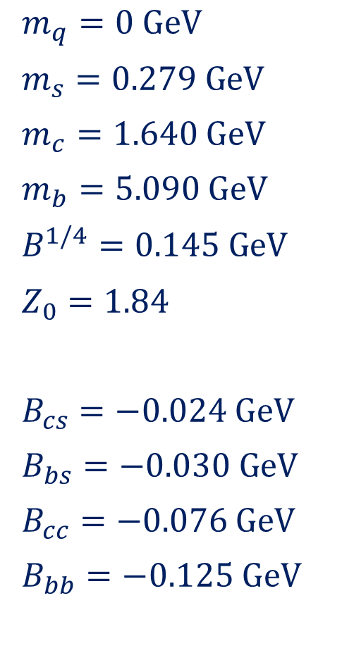
Numerical Results
K. Johnson, 1975, ACTA Physical Polonica
$m_{q}=0 GeV$
$m_{s}=0.279 GeV$
$m_{c}=1.640 GeV$
$m_{b}=5.090 GeV$
$B^{1/4}=0.145 GeV$
$Z_{0}=1.84$
$B_{cs}=−0.024 GeV$
$B_{bs}=−0.030 GeV$
$B_{cc}=−0.076 GeV$
$B_{bb}=−0.125 GeV$
Error Bar

Slide 9
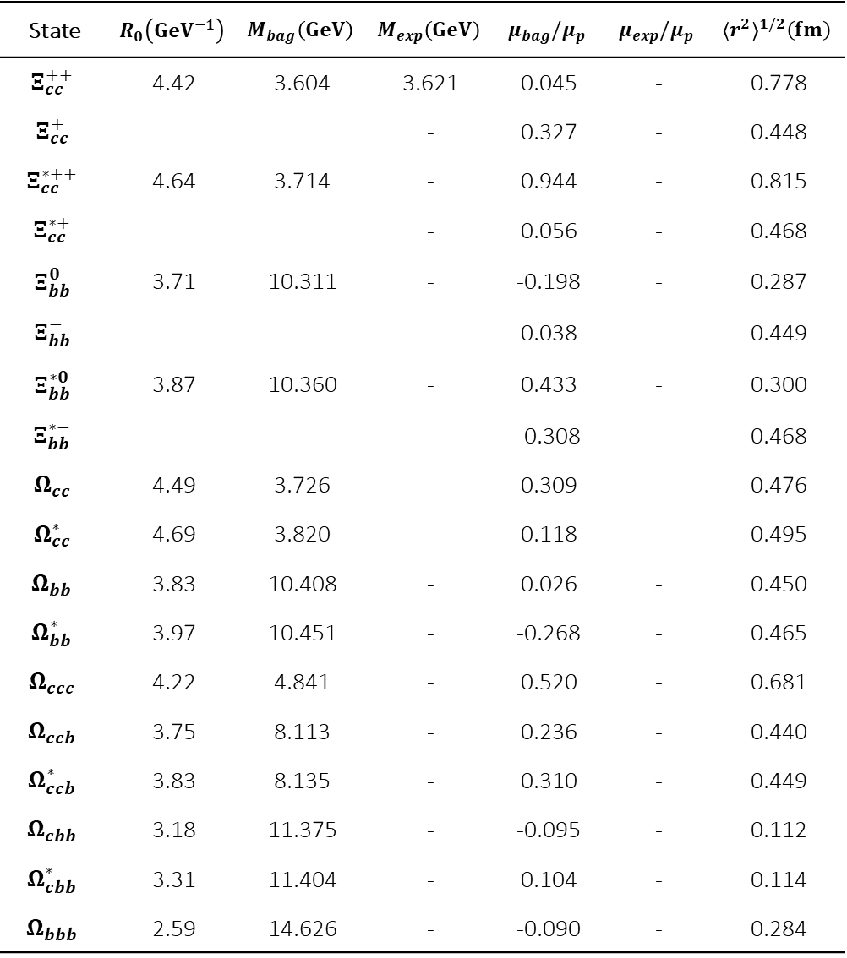
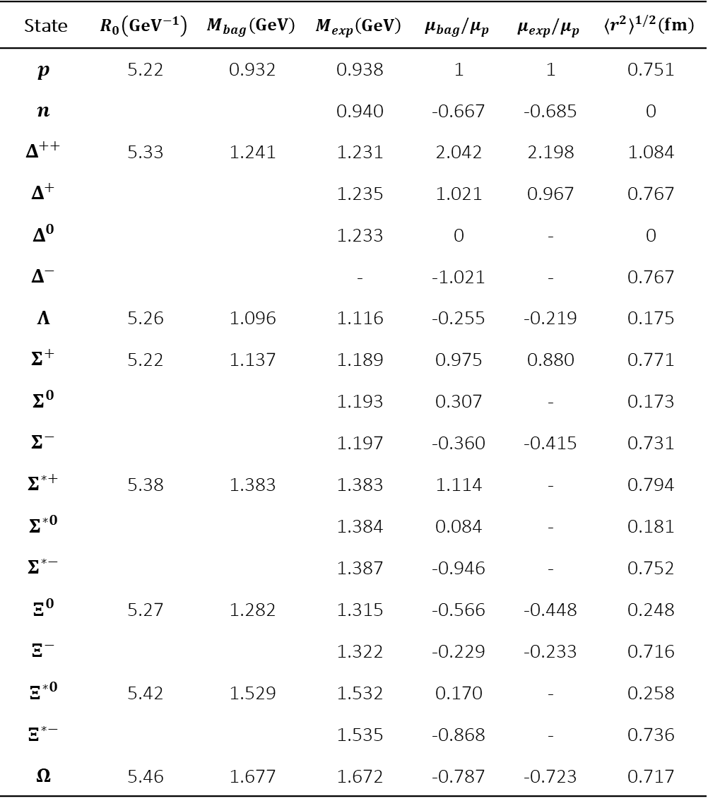
State | $$R_{0}\left({GeV}^{−1}\right)$$ | $$M_{bag}\left(GeV\right)$$ | $$M_{exp}\left(GeV\right)$$ | $$μ_{bag}/μ_{p}$$ | $$μ_{exp}/μ_{p}$$ | $${〈r^{2}〉}^{1/2}\left(fm\right)$$
$$p$$ | 5.22 | 0.932 | 0.938 | 1 | 1 | 0.751
$$n$$ |  |  | 0.940 | -0.667 | -0.685 | 0
$$Δ^{++}$$ | 5.33 | 1.241 | 1.231 | 2.042 | 2.198 | 1.084
$$Δ^{+}$$ |  |  | 1.235 | 1.021 | 0.967 | 0.767
$$Δ^{0}$$ |  |  | 1.233 | 0 | - | 0
$$Δ^{−}$$ |  |  | - | -1.021 | - | 0.767
$$Λ$$ | 5.26 | 1.096 | 1.116 | -0.255 | -0.219 | 0.175
$$Σ^{+}$$ | 5.22 | 1.137 | 1.189 | 0.975 | 0.880 | 0.771
$$Σ^{0}$$ |  |  | 1.193 | 0.307 | - | 0.173
$$Σ^{−}$$ |  |  | 1.197 | -0.360 | -0.415 | 0.731
$$Σ^{∗+}$$ | 5.38 | 1.383 | 1.383 | 1.114 | - | 0.794
$$Σ^{∗0}$$ |  |  | 1.384 | 0.084 | - | 0.181
$$Σ^{∗−}$$ |  |  | 1.387 | -0.946 | - | 0.752
$$Ξ^{0}$$ | 5.27 | 1.282 | 1.315 | -0.566 | -0.448 | 0.248
$$Ξ^{−}$$ |  |  | 1.322 | -0.229 | -0.233 | 0.716
$$Ξ^{∗0}$$ | 5.42 | 1.529 | 1.532 | 0.170 | - | 0.258
$$Ξ^{∗−}$$ |  |  | 1.535 | -0.868 | - | 0.736
$$Ω$$ | 5.46 | 1.677 | 1.672 | -0.787 | -0.723 | 0.717
State | $$R_{0}\left({GeV}^{−1}\right)$$ | $$M_{bag}\left(GeV\right)$$ | $$M_{exp}\left(GeV\right)$$ | $$μ_{bag}/μ_{p}$$ | $$μ_{exp}/μ_{p}$$ | $${〈r^{2}〉}^{1/2}\left(fm\right)$$
$$Ξ_{cc}^{++}$$ | 4.42 | 3.604 | 3.621 | 0.045 | - | 0.778
$$Ξ_{cc}^{+}$$ |  |  | - | 0.327 | - | 0.448
$$Ξ_{cc}^{∗++}$$ | 4.64 | 3.714 | - | 0.944 | - | 0.815
$$Ξ_{cc}^{∗+}$$ |  |  | - | 0.056 | - | 0.468
$$Ξ_{bb}^{0}$$ | 3.71 | 10.311 | - | -0.198 | - | 0.287
$$Ξ_{bb}^{−}$$ |  |  | - | 0.038 | - | 0.449
$$Ξ_{bb}^{∗0}$$ | 3.87 | 10.360 | - | 0.433 | - | 0.300
$$Ξ_{bb}^{∗−}$$ |  |  | - | -0.308 | - | 0.468
$$Ω_{cc}$$ | 4.49 | 3.726 | - | 0.309 | - | 0.476
$$Ω_{cc}^{∗}$$ | 4.69 | 3.820 | - | 0.118 | - | 0.495
$$Ω_{bb}$$ | 3.83 | 10.408 | - | 0.026 | - | 0.450
$$Ω_{bb}^{∗}$$ | 3.97 | 10.451 | - | -0.268 | - | 0.465
$$Ω_{ccc}$$ | 4.22 | 4.841 | - | 0.520 | - | 0.681
$$Ω_{ccb}$$ | 3.75 | 8.113 | - | 0.236 | - | 0.440
$$Ω_{ccb}^{∗}$$ | 3.83 | 8.135 | - | 0.310 | - | 0.449
$$Ω_{cbb}$$ | 3.18 | 11.375 | - | -0.095 | - | 0.112
$$Ω_{cbb}^{∗}$$ | 3.31 | 11.404 | - | 0.104 | - | 0.114
$$Ω_{bbb}$$ | 2.59 | 14.626 | - | -0.090 | - | 0.284

Slide 10
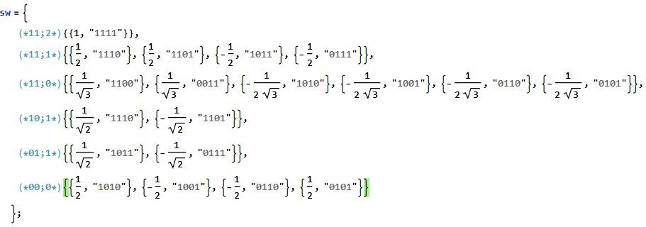
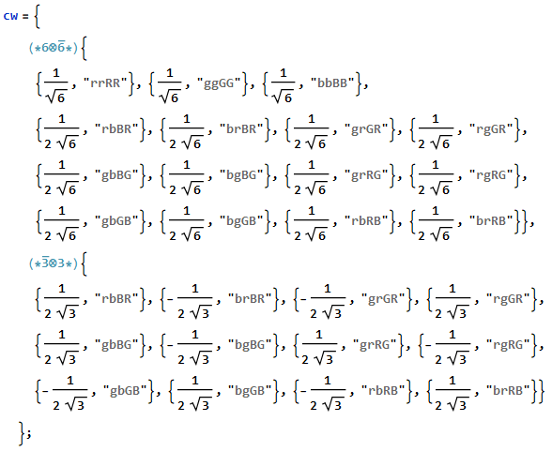
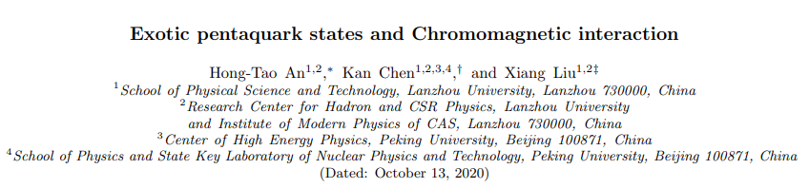
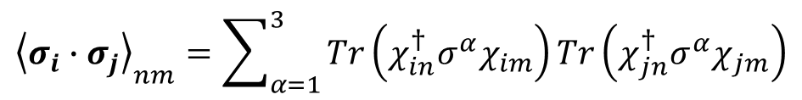
Problem 1: Spin & Color Wave Function
$${\left\langle σ_{i}∙σ_{j}\right\rangle }_{nm}=\sum_{α=1}^{3}{Tr\left(χ_{in}^{†}σ^{α}χ_{im}\right)}Tr\left(χ_{jn}^{†}σ^{α}χ_{jm}\right)$$

Slide 11
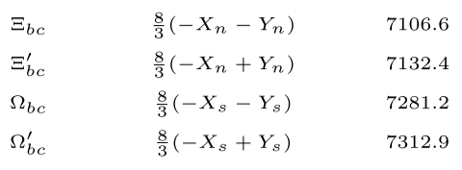
Problem 2: Mixing of what?
Consider a mixing of spin states as $\left|\left.1,\frac{1}{2};\frac{1}{2}\right\rangle \right.$ and $\left|\left.0,\frac{1}{2};\frac{1}{2}\right\rangle \right.$ in calculating $\left\langle σ_{i}∙σ_{j}\right\rangle$
1. $\left(\begin{matrix}C_{12}−2C_{13}−2C_{23} & −\sqrt{3}C_{13}+\sqrt{3}C_{23} \\ −\sqrt{3}C_{13}+\sqrt{3}C_{23} & −3C_{12}\end{matrix}\right)⇒$ violate MIT Bag Model
2. $\left(\begin{matrix}H_{nn}^{0}+H_{nn}^{CMI} & H_{nm}^{0}+H_{nm}^{CMI} \\ H_{mn}^{0}+H_{mn}^{CMI} & H_{mm}^{0}+H_{mm}^{CMI}\end{matrix}\right)⇒$ losing of x and R, then magnetic moments
3. $H^{′}=\left(\begin{matrix}C_{12}−2C_{13}−2C_{23} & 0 \\ 0 & −3C_{12}\end{matrix}\right)⇒$ even cruder results

Slide 12

$$Tha\text{nks} \text{for} \text{your} \text{attention}$$

